Slide 1
Understanding Public Sentiment on Health Topics in Reddit Communities
Richardson Chhin, Niyam Acharya,
Sahil Adhikari, Benson Zhang

Slide 2
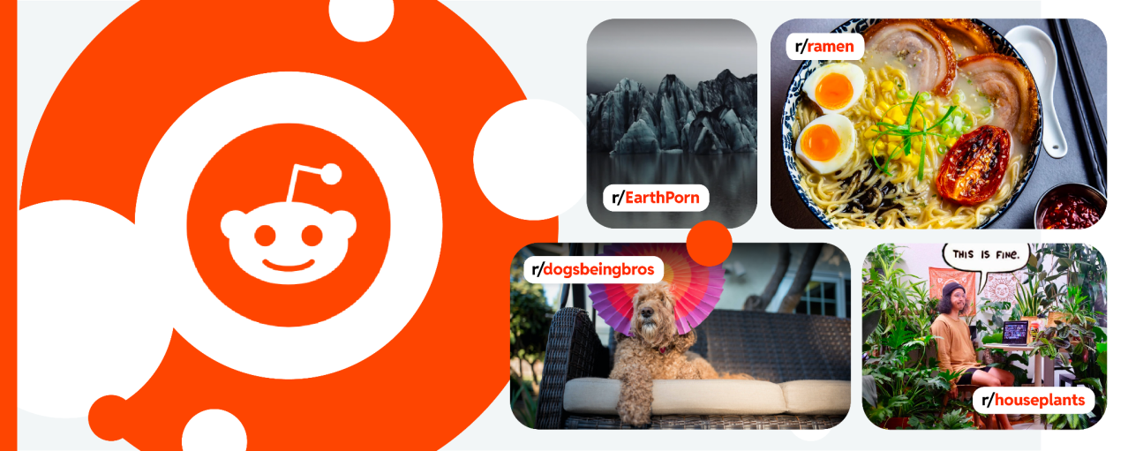
Introduction and Motivation
In our current time of technology, information is everywhere.
Allowing us, many opportunities to improve ourselves throughout our lives.
Yet, in our current time of the digital age, social media is very popular, but not all of them consistently regulated
With that in mind, our aim is to try to locate good advice from Reddit’s health communities
Notes:
In our current time of technology, information is everywhere.
This allows us to have plenty of opportunities of ways to improve ourselves throughout our lives.
Like where do you usually go to for health or life advice? (Maybe u go to a doctor, ur therapist, a mentor, a teacher, or maybe you google, find videos on youtube, or look at posts from other social media sites like Reddit)
Yet, in our current time of the digital age, social media is like everywhere, but not all of them consistently regulated
So, with that in mind, our aim is to try to locate good advice from Reddit’s health communities, and try to simplify the process of starting and maintaining a healthy habit to essentially help individuals make more well-informed decisions

Slide 3
Methodology
Problem Overview: In the digital age, understanding public sentiment on health topics is crucial. Social media platforms like Reddit are rich sources of public opinion but are often underutilized for extracting actionable insights. The challenge is to systematically analyze the sentiment expressed in Reddit’s health communities to better understand public attitudes toward various health issues, treatments, and policies.
Solution Overview: Our solution involves a comprehensive sentiment analysis of posts and comments from selected health-related subreddits. This analysis will be conducted in four main stages: Data Collection, Preprocessing, Sentiment Analysis, and Visualization and Interpretation

Slide 4
Data Collection
Using the Reddit API, we will extract posts and comments from targeted health subreddits such as r/health, r/AskDocs, and r/mentalhealth with credentials obtained from registering an application on Reddit’s developer platform. These credentials will ensure authorized interaction with the Reddit API.

Slide 5
2. Data Cleaning and Preprocessing
Cleaning
Text Cleaning: Posts and comments undergo preprocessing to remove special characters, URLs, and stop words. This step ensures that the text data is clean and suitable for analysis.
Tokenization
Text data is tokenized using the Natural Language Toolkit (NLTK) to break it into individual words or tokens. This process prepares the text for subsequent sentiment analysis

Slide 6
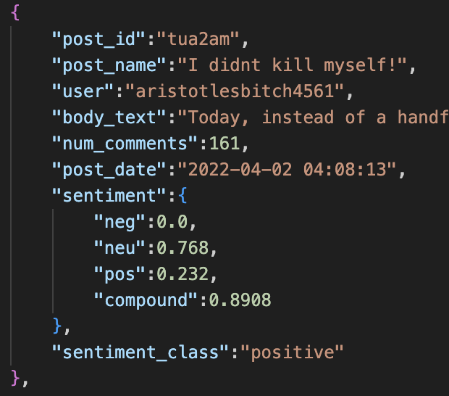
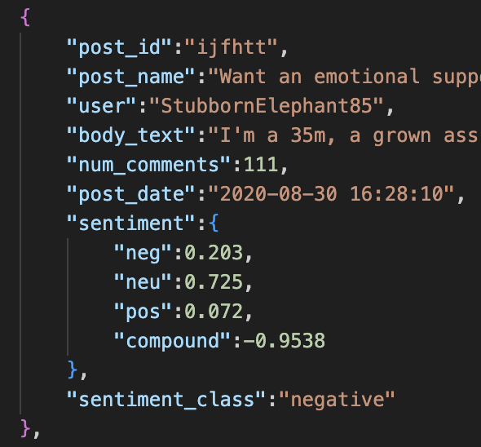
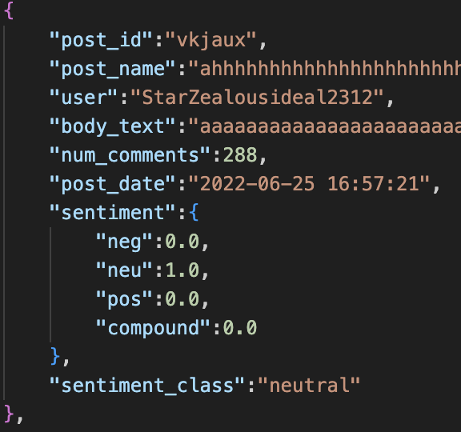
3. Sentiment Analysis
Analysis: We will apply Natural Language Processing (NLP) techniques to assess the sentiment of the text data. This involves using sentiment analysis models to classify the text into positive, negative, or neutral categories.
EX: VADER (Valence Aware Dictionary and sEntiment Reasoner) Tool

Slide 7
4. Visualization
Word Clouds: Represent the most frequently mentioned terms in the posts and comments. They provide an intuitive view of the most common words related to various health topics.
Sentiment Distribution Graphs: Show the overall sentiment breakdown of the collected data, allowing us to understand the proportion of positive, negative, and neutral sentiments.
Bar Charts: Help compare the volume of posts or comments with different sentiment scores across various subreddits or health topics.
Pie Charts: Show the proportion of different sentiment categories within a particular subreddit or across the entire dataset
Line Graphs for Time-Series Sentiment Analysis with positive, negative, and neutral lines for each subreddit.

Slide 8
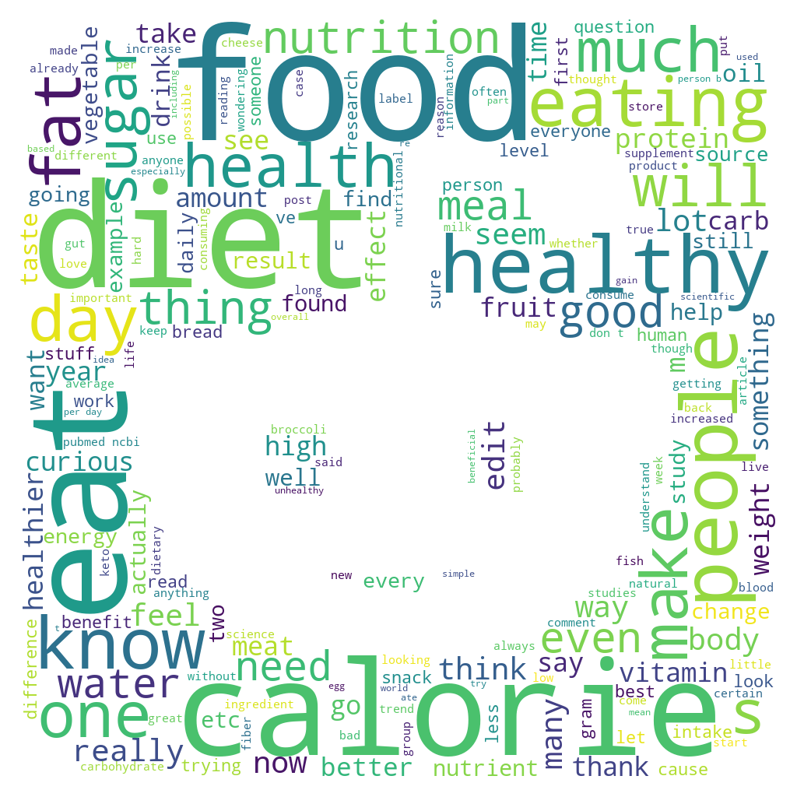
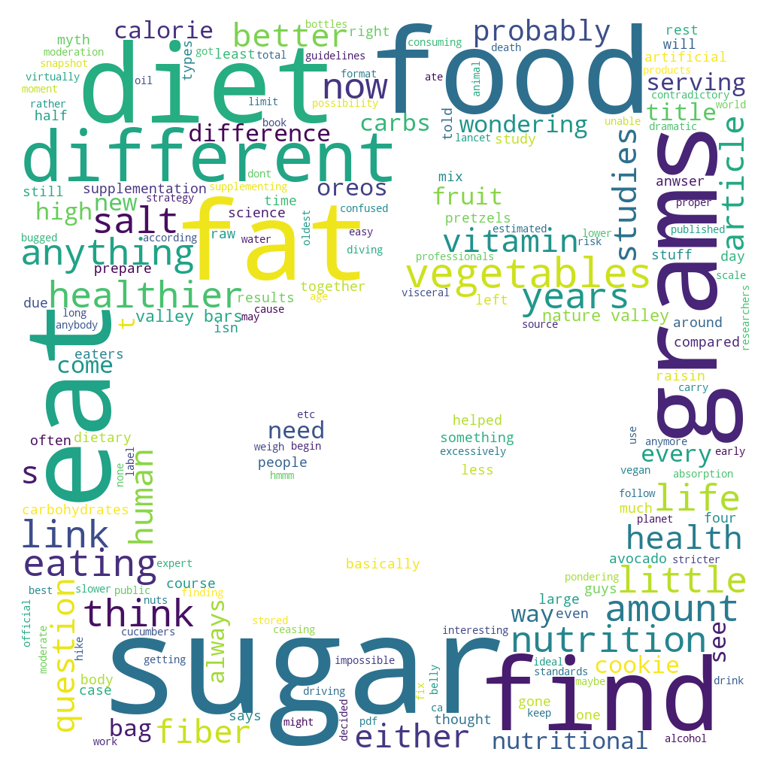

Slide 9
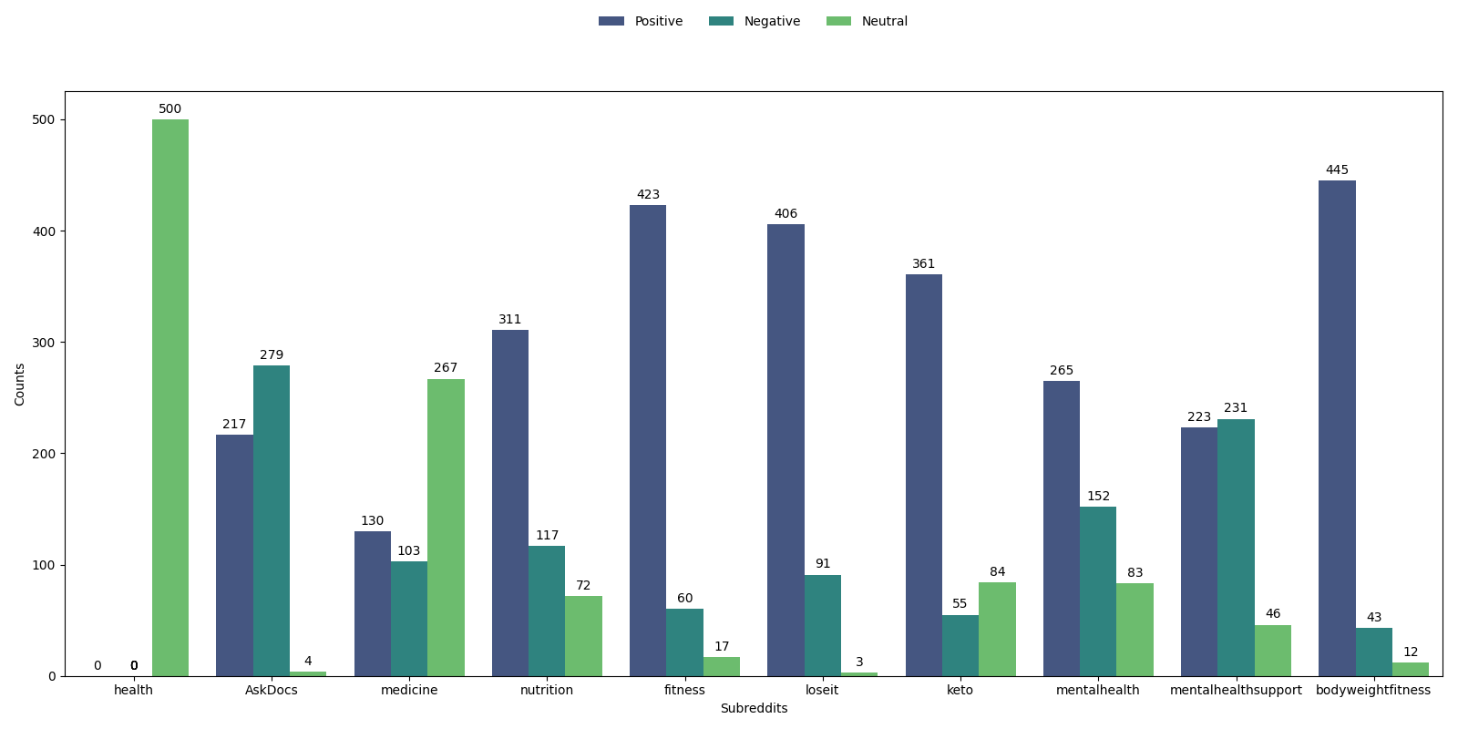

Slide 10
Overall Sentiment Distribution
Analyzed and visualized the overall sentiment distribution across selected subreddits.
Classified posts into positive, neutral, and negative sentiments using pre-existing sentiment scores.
Combined sentiment data from all subreddits to understand the overall sentiment landscape.

Slide 11
Majority of the posts are positive, indicating a generally optimistic community.
Significant presence of negative and neutral content, reflecting a balance between supportive and factual or critical discussions.

Slide 12
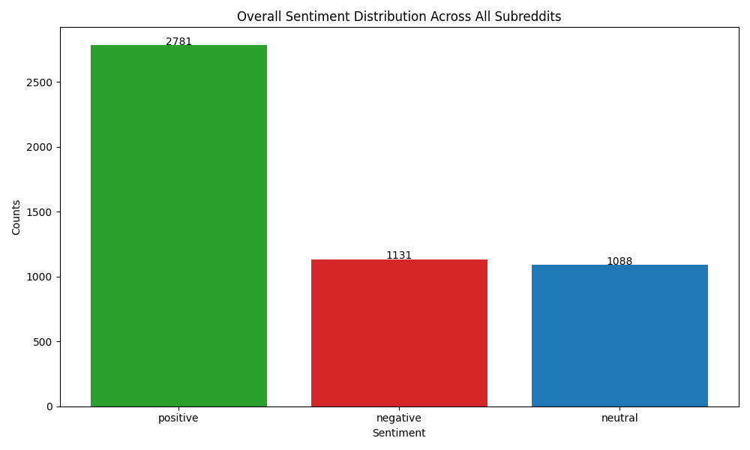

Slide 13
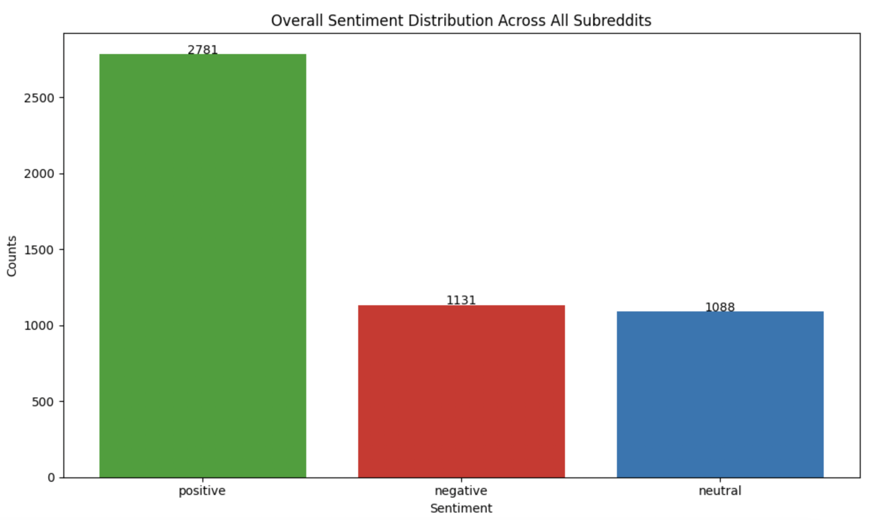
Overall Sentiment Distribution - Sahil
The sentiment distribution analysis showed that positive sentiments dominated all subreddits, implying a generally supportive and optimistic community environment.

Slide 14
Time-Series Sentiment Analysis
What is it?
Tracks sentiment changes over time.
Why Important?
Reveals trends and public opinion shifts.
Consistent positive sentiment might indicate a supportive community, while fluctuating sentiments could point to contentious topics.
How Done?
Sentiment scores by month from 2014 to 2024
Plot sentiment proportions over time.
Notes:
The time-series sentiment analysis is a crucial part of our project as it allows us to observe how sentiment changes over time within these health communities. This type of analysis helps us identify trends and shifts in public opinion, which can be particularly useful for understanding how significant events or emerging health issues affect people's attitudes.
The methodology we used involved calculating sentiment scores for each post and then grouping these by time intervals, such as monthly. By plotting the proportions of positive, neutral, and negative sentiments over time, we can visualize how the overall sentiment within a subreddit changes.
From the slides you see here, some subreddits show clear fluctuations, which could be tied to specific events or discussions happening within the community. For example, a sudden increase in negative sentiment might coincide with a public health scare or controversy.
Understanding these patterns is important as it provides insights into how public sentiment can influence and reflect the collective mindset within these communities.
The frequency of posts and the variety of sentiment could also give insights into how active and engaged the community is in a given subreddit. For instance, consistent positive sentiment might indicate a supportive community, while fluctuating sentiments could point to contentious topics.

Slide 15
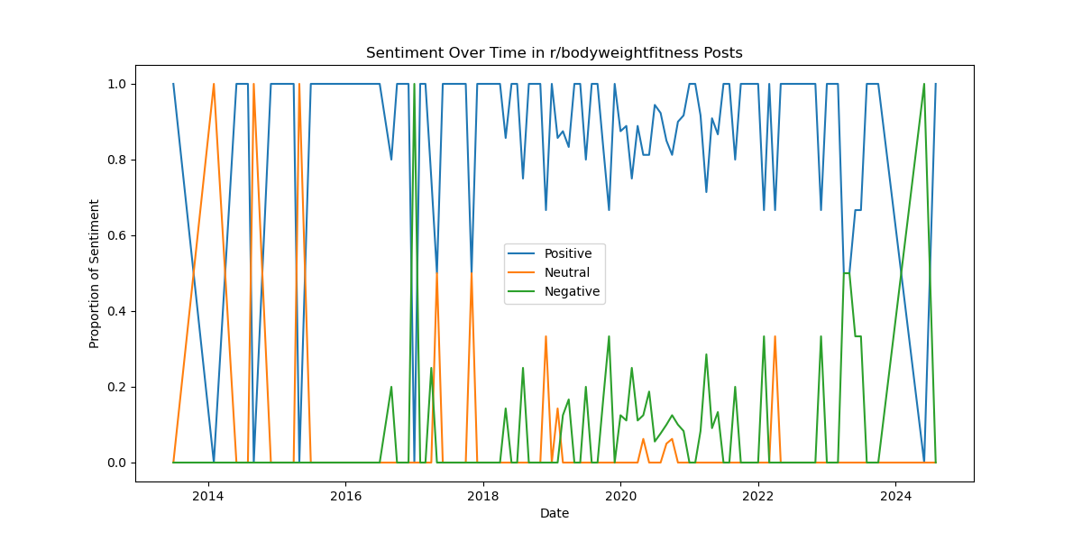
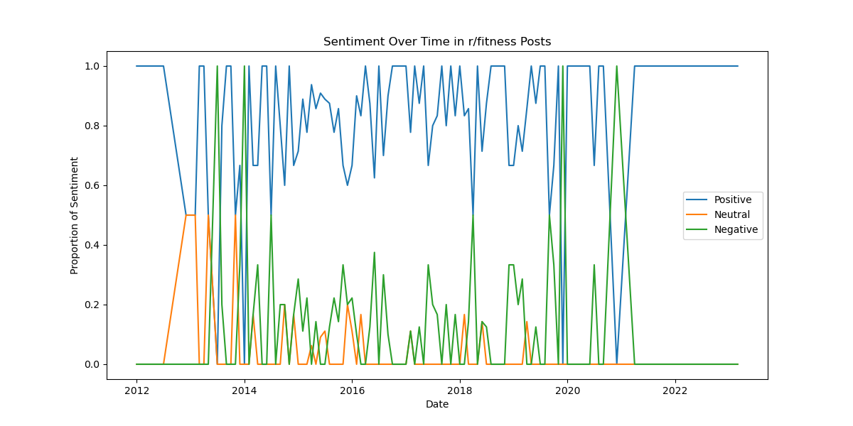
Notes:
Subreddit: r/bodyweightfitness (2014-2024):
Early 2014 to 2016: Frequent shifts between positive and neutral sentiment with some negative spikes. This could indicate discussions about the challenges and benefits of bodyweight exercises, which might reflect mixed experiences from users.
Post-2016: More consistent positive sentiment with occasional dips. This could be due to more people sharing success stories or tips, leading to an overall positive outlook in the subreddit.
Subreddit: r/fitness (2012-2022):
2012 to 2016: High variability with fluctuating sentiment. This period might reflect the diverse opinions about different fitness trends, methods, and perhaps the rise of new fitness influencers or debates on workout techniques.
Post-2016: A slight increase in positive sentiment, potentially corresponding with more community-driven support and success stories as the fitness culture became more mainstream.

Slide 16
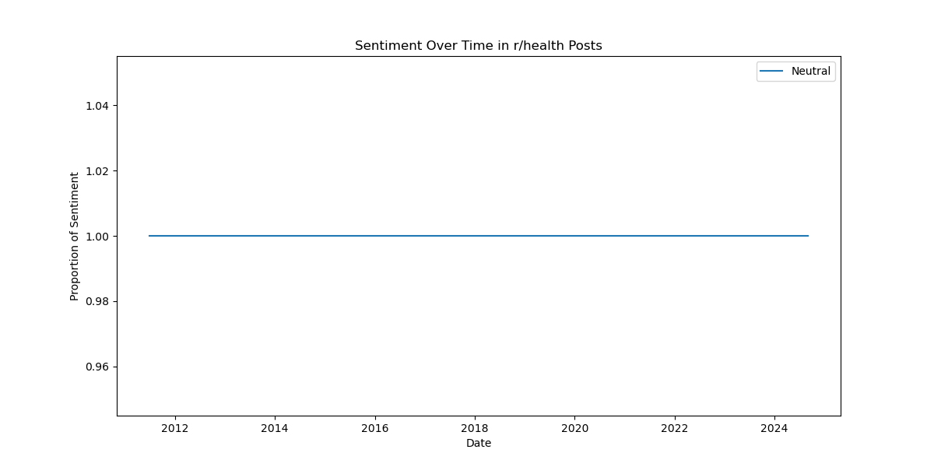
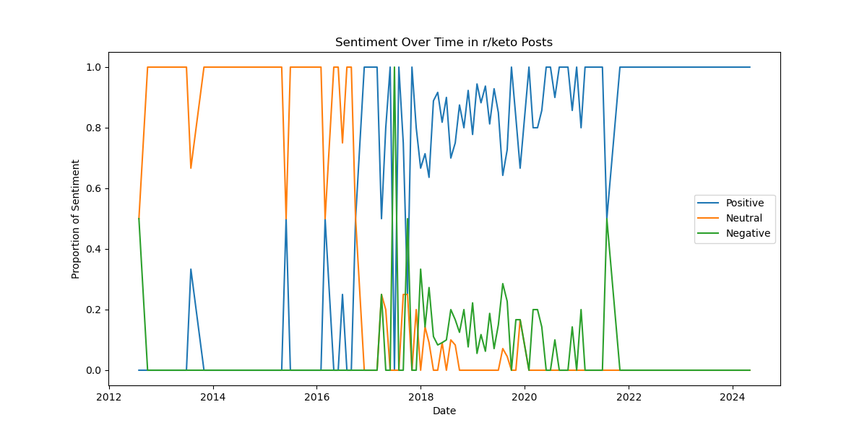
Notes:
Subreddit: r/keto (2012-2024):
2012 to 2016: A mix of positive, neutral, and negative sentiments. This period might capture the early debate over the keto diet, with discussions about its benefits and drawbacks.
Post-2016: A more dominant positive sentiment, which could align with the growing popularity and acceptance of the keto diet as an effective weight-loss strategy.

Slide 17
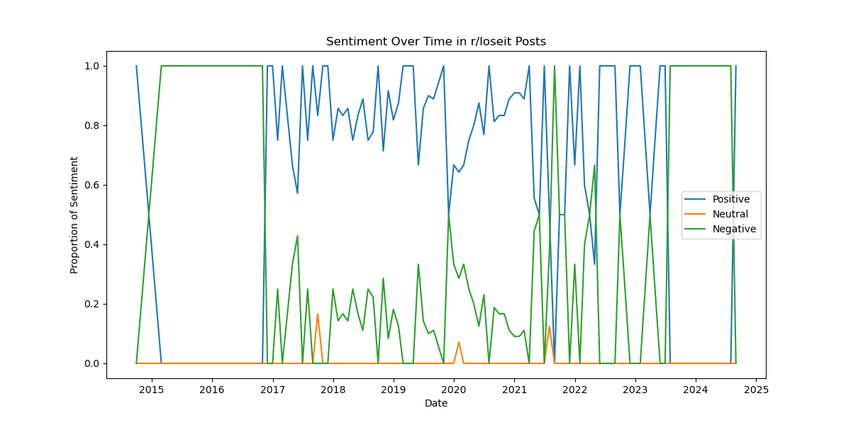
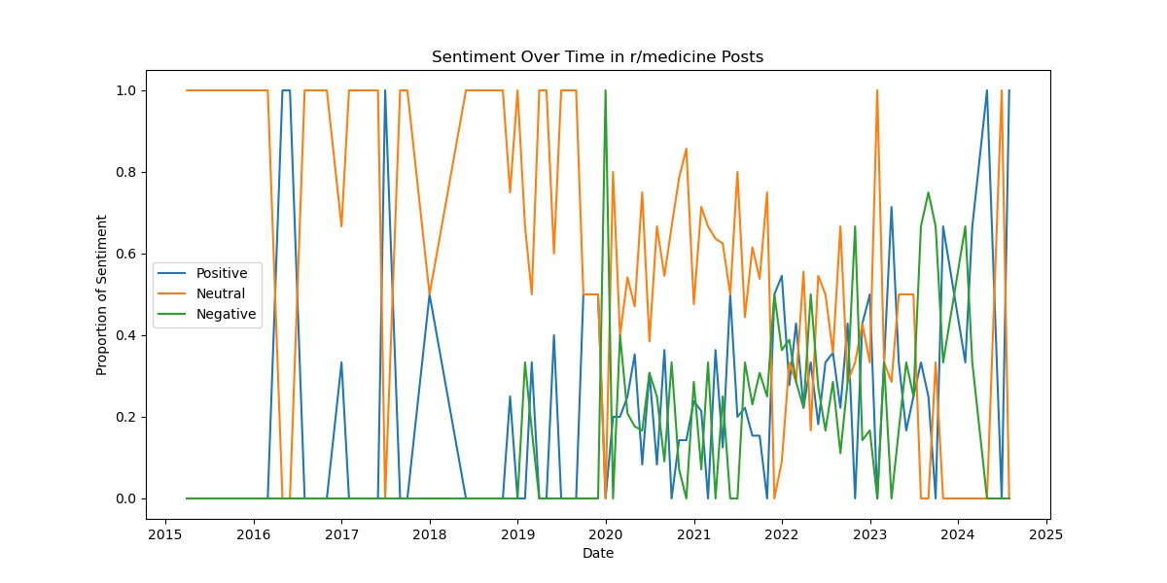
Notes:
Subreddit: r/loseit (2015-2025):
2015 to 2025: Noticeable spikes in positive sentiment with some variability. This could be linked to successful weight loss stories and motivation shared among the community, interspersed with challenges people face on their journey.
Subreddit: r/medicine (2015-2025):
2015 to 2025: High levels of neutral sentiment with increasing variability. This might be due to discussions around medical information and news, where factual information is predominant but occasionally influenced by personal opinions or debates on controversial topics.

Slide 18
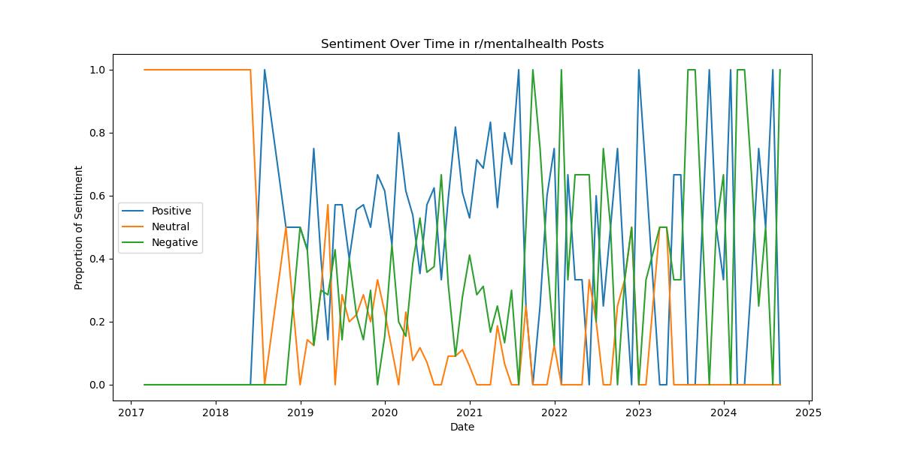
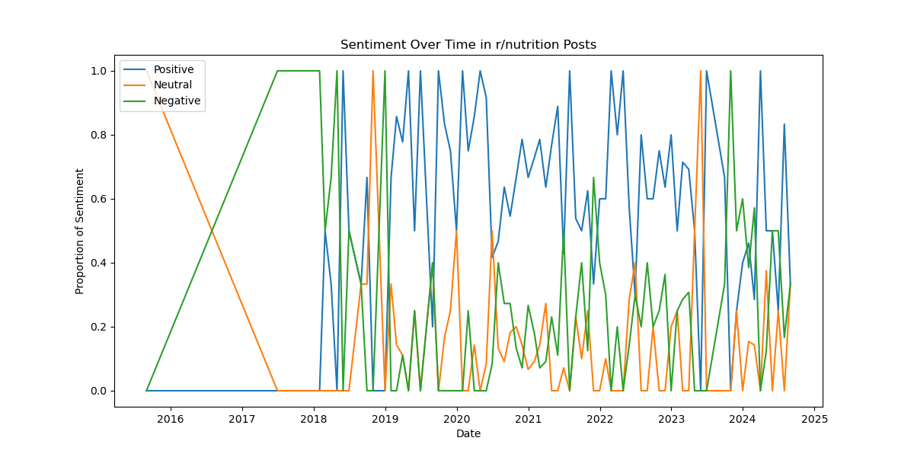
Notes:
Subreddit: r/mentalhealth (2017-2025):
2017 to 2025: A complex mix of sentiments, possibly reflecting the sensitive nature of mental health discussions, where both support and challenges are openly discussed, leading to fluctuations in the emotional tone.
Subreddit: r/nutrition (2016-2025):
2016 to 2025: High variability with shifting sentiments, likely tied to debates on nutritional advice, trends (e.g., veganism, paleo, supplements), and the diverse opinions on what constitutes a healthy diet.

Slide 19
Experimental Results
Explain the tests you performed (and why)
Our tests were trying to get a few posts from one and multiple subreddits. Then later, we also tried sentiment analysis on a few texts to see if it works.
Explain how you gathered the data
We use the Reddit API, PRAW, to gather our posts from different subreddits, and the VADER model and BERT model to predict sentiment
Present your key results (Choose quality over quantity)
Discuss your results.
Explain/interpret your results (possibly compare your results to related work). Explain why your results fit (or don't fit) what you expected. Do not just present data and leave it up to the audience to infer what the data show and why it is interesting.

Slide 20
Challenges
Data Volume: Handling large datasets from multiple subreddits would slow down processing and require more time than expected.
Sentiment Misclassification: Sentiment analysis might incorrectly classify complex or sarcastic posts, affecting the accuracy of the results.
Tool Integration: Integrating different tools and libraries smoothly, especially when each team member uses different environments, caused some compatibility issues.

Slide 21
Lesson Learned
Team Collaboration
Sentiment Analysis Complexity:
Challenges of sentimental analysis, particularly in accurately classifying neutral sentiments, which sometimes overlap with positive or negative tones.
Time series sentimental analysis helps us understand the emotion of people’s posts during that timeline; for example: huge number of negative sentiments during COVID-19 in r/mentalhealth.
Time Management: The project reinforced the importance of setting realistic deadlines and regularly checking progress to avoid last-minute issues.

Slide 22
Conclusions & Future Directions
Conclude with the main ideas and results of your work.
Discuss lessons learned and future directions for your work
What were the key challenges? Did you learn anything surprising? Choosing and applying sentiment models
What lessons did you learn from your project?
What was difficult?
What do you wish you could have done (or done differently)? We wish we could have done something that could have extracted and formulated concrete advice from the reddits posts data
How could your project be extended...what's next? Our project can be extended by extracting and conclusing good advice from our posts data
Are there any interesting problems or questions that resulted from your work? Some questions we have are, how would you have approached in tackling this problem?

Slide 23
Areas for Enhancement
Broader Data Scope: Including more subreddits or other social media platforms could have provided a more comprehensive view of sentiment trends across different communities.
Deeper Sentiment Analysis: Could have used more advanced sentiment analysis techniques to capture nuances such as sarcasm or mixed emotions.

Slide 24
Are there any interesting problems or questions that resulted from our work?
Sentiment Misclassification:
How can we improve the accuracy of sentiment classification, particularly for neutral or mixed sentiments?
Impact of External Events:
How do significant events (e.g., pandemics, health campaigns) influence sentiment trends in these communities?
Cross-Platform Comparisons:
Would sentiment trends differ if we analyzed similar health discussions on other platforms like Twitter or YouTube?
Temporal Shifts:
Can we predict future sentiment trends based on historical data, and how reliable would these predictions be?
Notes:
As we conducted our analysis, several interesting questions emerged that could be the focus of future research. One major challenge we faced was sentiment misclassification, especially when it came to neutral or mixed sentiments. This raises the question of how we can refine our models to better capture these nuances.
Another intriguing area to explore is the impact of external events on sentiment. For example, how do major health crises like the COVID-19 pandemic affect the sentiment within these communities? Understanding this could help public health officials gauge public reaction to their policies.
We also wondered how sentiment trends might differ across platforms. For instance, would we see the same trends on Twitter or YouTube? This could be an interesting comparison to make, as it would reveal how platform-specific cultures influence sentiment.
Finally, with the data we have, we could explore the possibility of predicting future sentiment trends. However, this brings up the question of how reliable such predictions would be and what factors would need to be considered.

